Slide 1

Churn Rates
Analyze Data with SQL
Mario Giraldo
6/1/2025

Slide 2
Project Summary
Calculate subscription churn rates for a start up company that launched 4 months ago.
Specifically compare churn rates between two segments of users.
A user cannot start and end their subscription in the same month

Slide 3
Subscriptions table
-From the first 100 entries there are two different segments, “87” and “30”.
-Subscription start date is December 1st, 2016.
-Subscription end date is March 30th, 2017.
-Given a customer is considered actively subscribed if they are subscribed before the beginning of any month where churn is being calculated, churn rate may only be calculated for the months of January-March 2016.
-- Looking at first 100 rows of data
SELECT *
FROM subscriptions
LIMIT 100;
SELECT MIN(subscription_start),
MAX(subscription_start)
FROM subscriptions;

Slide 4
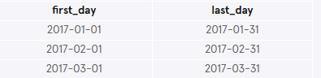
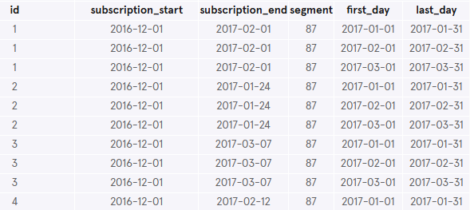
Temporary table - months
-- Creating temporary table of months available for churn calculations (January, Feb, March of 2017).
WITH months AS
(SELECT
'2017-01-01' as first_day,
'2017-01-31' as last_day
UNION
SELECT
'2017-02-01' as first_day,
'2017-02-31' as last_day
UNION
SELECT
'2017-03-01' as first_day,
'2017-03-31' as last_day)
SELECT*
FROM months;
--- Union addition:
cross_join AS
(SELECT*FROM subscriptions
CROSS JOIN months)
SELECT*FROM cross_join LIMIT 10;

Slide 5
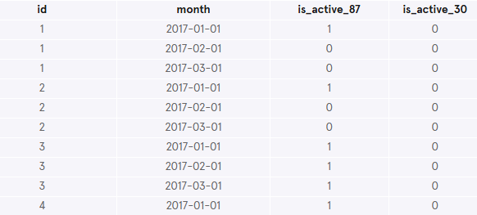
Temporary table - status
-- Creating temporary table of statuses from the cross_join table
status AS
(SELECT id, first_day AS month,
CASE
WHEN(subscription_start < first_day) AND (subscription_end > first_day OR subscription_end IS NULL) AND (segment=87) THEN 1 ELSE 0
END AS is_active_87,
CASE
WHEN(subscription_start < first_day) AND (subscription_end > first_day OR subscription_end IS NULL) AND (segment=30) THEN 1 ELSE 0
END AS is_active_30
FROM cross_join)
SELECT*FROM status LIMIT 10;

Slide 6
Temporary table – adding to status table
-- Creating temporary table of statuses from the cross_join table
status AS
(SELECT id, first_day AS month,
CASE
WHEN(subscription_start < first_day) AND (subscription_end > first_day OR subscription_end IS NULL) AND (segment=87) THEN 1 ELSE 0
END AS is_active_87,
CASE
WHEN(subscription_start < first_day) AND (subscription_end > first_day OR subscription_end IS NULL) AND (segment=30) THEN 1 ELSE 0
END AS is_active_30
FROM cross_join)
SELECT*FROM status LIMIT 10;

Slide 7
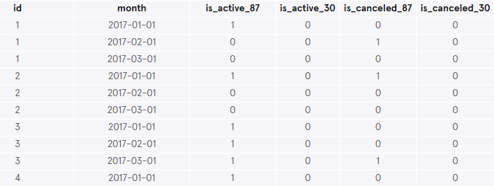
Temporary table – adding canceled to status table
-- Adding canceled columns to status table
CASE
WHEN(subscription_end BETWEEN first_day AND last_day) AND (segment =87) THEN 1 ELSE 0
END AS is_canceled_87,
CASE
WHEN(subscription_end BETWEEN first_day AND last_day) AND (segment =30) THEN 1 ELSE 0
END AS is_canceled_30
FROM cross_join)
SELECT*FROM status LIMIT 10;

Slide 8
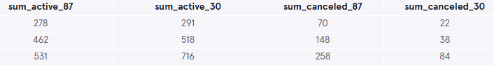
Temporary table – status_aggregate
-- Creating status aggregate table
status_aggregate AS
(SELECT
SUM(is_active_87) AS sum_active_87,
SUM(is_active_30) AS sum_active_30,
SUM(is_canceled_87) AS sum_canceled_87,
SUM(is_canceled_30) AS sum_canceled_30
FROM status
GROUP BY month)
SELECT*FROM status_aggregate;

Slide 9
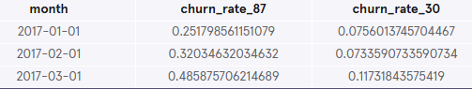
Temporary table – Churn Rates!
-Churn rates for segment 30 were significantly less.
-In order to customize the code to accommodate a large number of segments, adding a ‘segment’ column to the ‘status’ table and grouping by ‘segment’ would allow for scaling.
-- Creating status aggregate table
status_aggregate AS
(SELECT
SUM(is_active_87) AS sum_active_87,
SUM(is_active_30) AS sum_active_30,
SUM(is_canceled_87) AS sum_canceled_87,
SUM(is_canceled_30) AS sum_canceled_30
FROM status
GROUP BY month)
SELECT*FROM status_aggregate;
---Calculating Churn rates:
SELECT month,
1.0 * sum_canceled_87/sum_active_87 AS churn_rate_87,
1.0 * sum_canceled_30/sum_active_30 AS churn_rate_30
FROM status_aggregate;

